Slide 1
Optimal computation of avoided words
Hélène Perée
Madalina Ciortan

Slide 2
From formal language theory to genomics
DNA sequences = words on a fixed sized alphabet
Non/Coding DNA has many statistical features common with natural languages (EX)
DNA avoided words:
Destabilize chromatin/genomic conformation
Target of restriction endonuclease
Signaling roles (initiation of transcription/DNA replication)
Insulators
Functions yet to be discovered

Slide 3
Terminology
Alphabet
Integer alphabet : letters is replaced by rank : {1,…,n}
Word : x=x[0]x[1]⋯x[n−1] word of length n=|x|
Occurrence of word w=w[0]w[1]⋯w[m−1] 0<m≤n when w = x[i… i+m-1]
Factor of x = substring of x from i to j
Prefix = factor that starts at position 0 (x[0…j]x[0…j])
Suffix = factor that ends at position n−1 (x[i…n−1])
Infix = factor that is neither a prefix nor a suffix of x

Slide 4
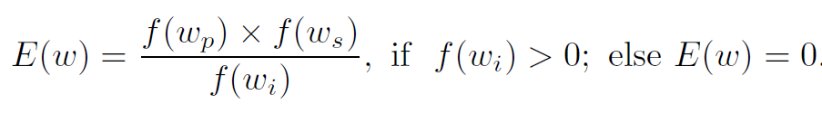
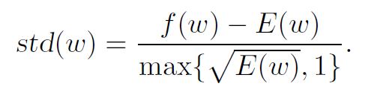
Metrics
Expected frequency
Standard deviation
Objective : std(w) ≤ ρ

Slide 5
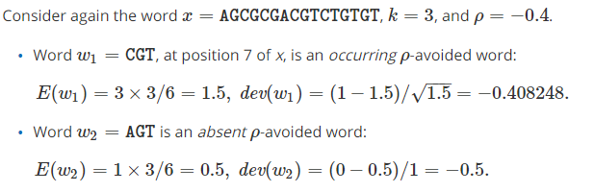
Example

Slide 6
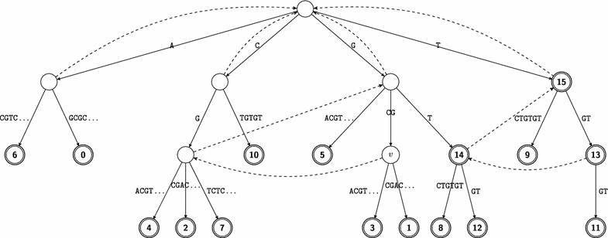
Suffix trees
Implicit/explicit nodes
Word depth
Terminal node
Suffix link
Child(v, a)

Slide 7
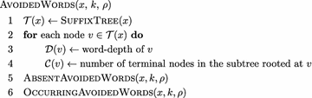
Algorithms
O(n) time complexity- avoided words of length k
O(σn) time complexity - avoided words of any length

Slide 8
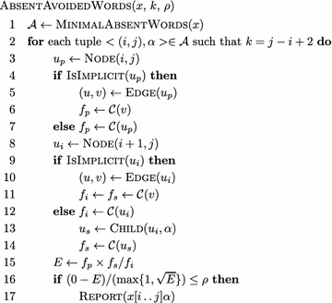
Absent avoided words

Slide 9
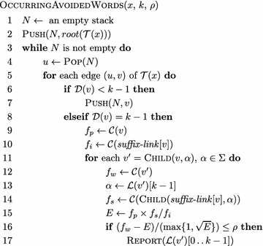
Occurring avoided words

Slide 10
Theorems and lemmas
The paper proves mathematically the following points:
Any absent ρρ-avoided word w in x is a minimal absent word of x.
etc

Slide 11
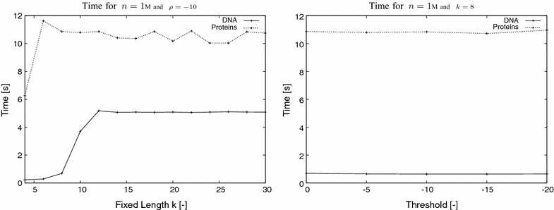
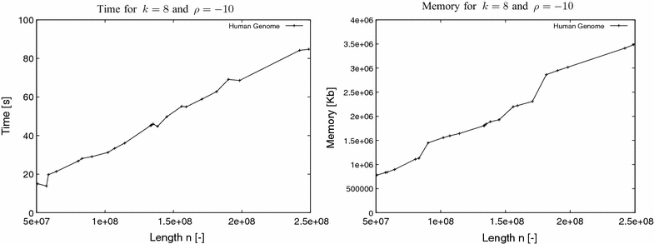
Experimental results

Slide 12
Correctness

Slide 13
Critique

Slide 14
Conclusions

Slide 15
References
https://almob.biomedcentral.com/articles/10.1186/s13015-017-0094-z

